Slide 1

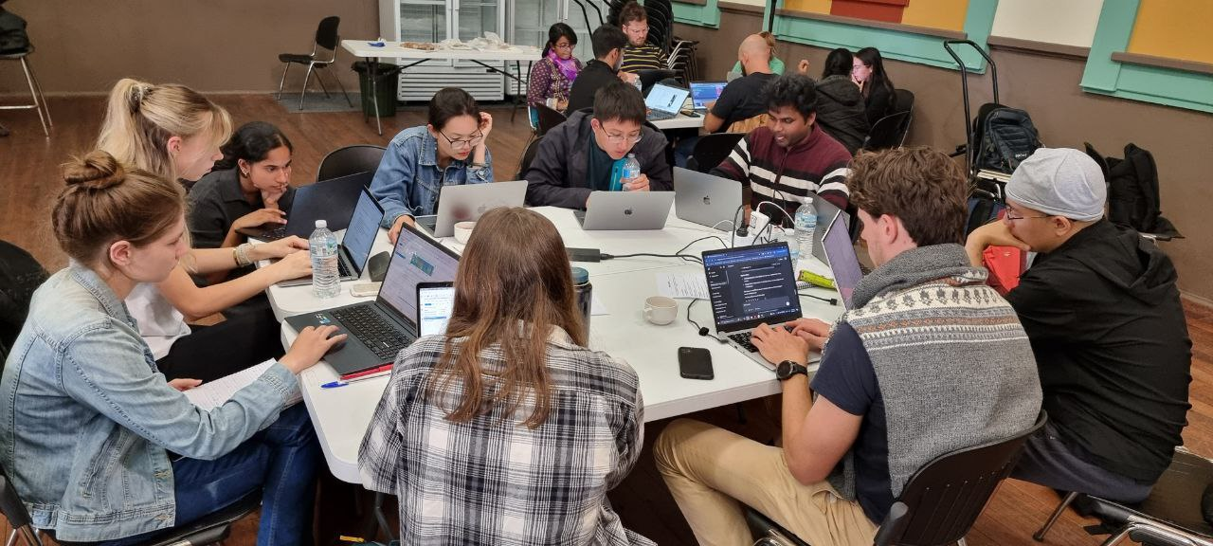
Exploring the impacts of aerosols, precipitation and meteorological factors on open and closed MCC clouds (case study)
Team Members: Yi, Nasim, Kyndra, Emily, Britty, Zhaoyang, Jason, Hayley, Abhishek, Carl
Summer School, Cape Grim, 2025

Slide 2
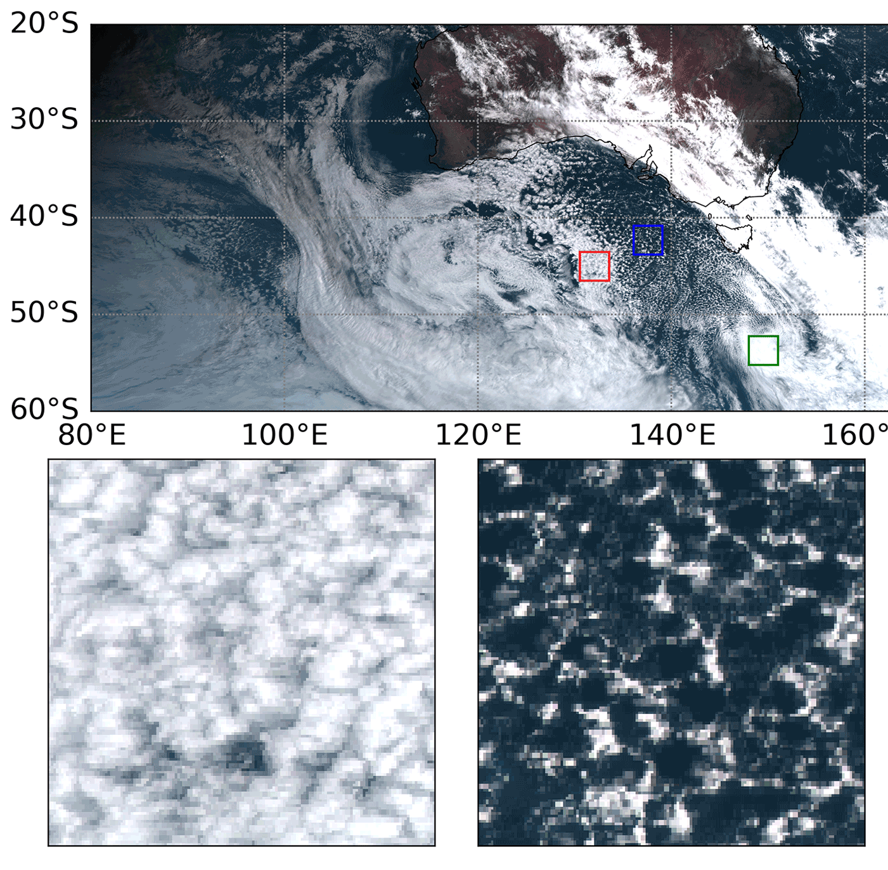
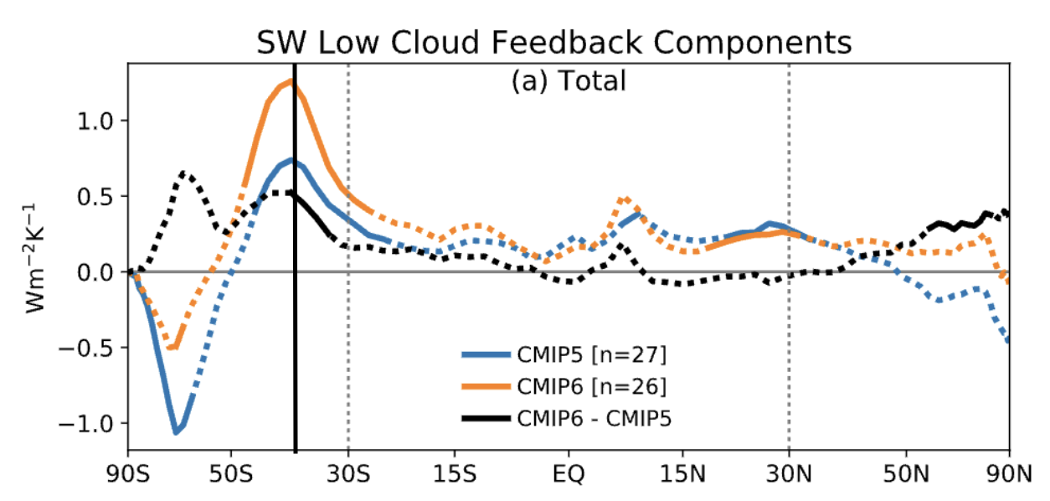
Background
Zelinka et al., 2020
Lang et al., 2022

Slide 3
Science Questions
Do the open and closed MCC clouds have different aerosol (e.g. CCN/CN) characteristics?
Do the open and closed MCC clouds have different precipitation characteristics?
Are there environmental or meteorological factors (e.g. wind, atmospheric stability) modulate the relationships you observe above?

Slide 4
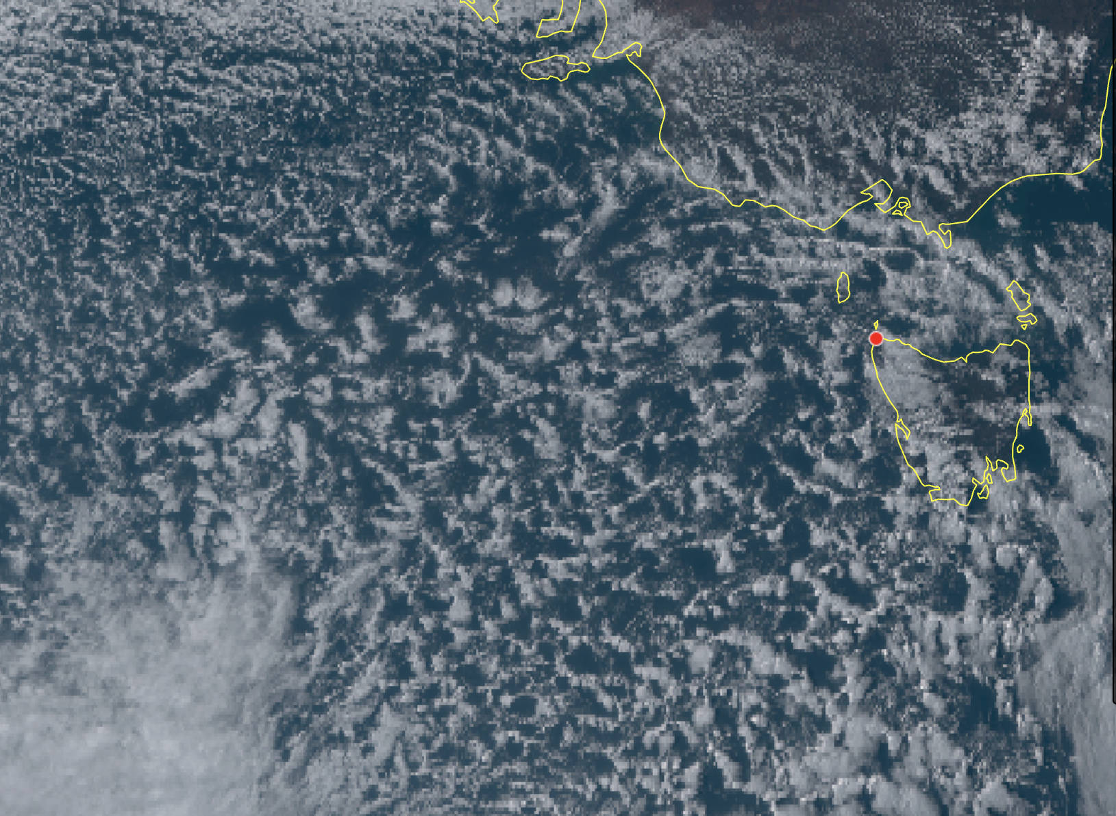
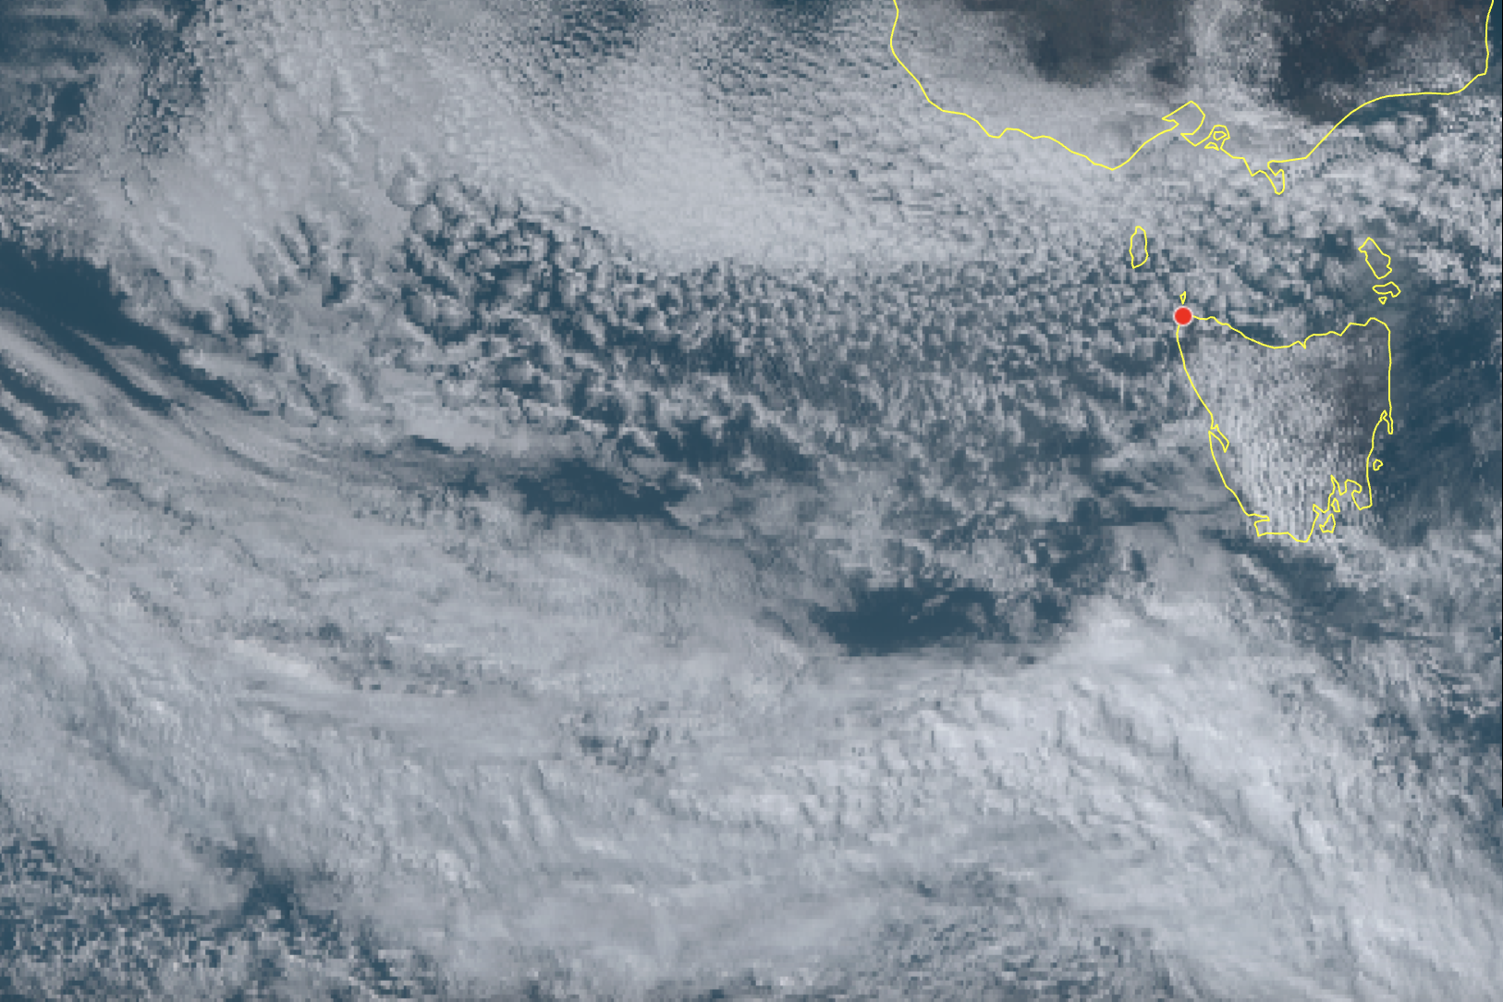
Our Case Study
OPEN MCC – 2024/09/19 06:00:00 UTC (2024/09/19 05:00:00 – 2024/09/19 10:00:00)
CLOSE MCC – 2024/09/17 05:00:00 UTC (2024/09/16 22:00:00 – 2024/09/17 08:00:00)

Slide 5
Meteorological data
MSLPs
Soundings___both in base line
Wind roses

Slide 6
Clouds

Slide 7
Precipitation

Slide 8
CCN/Radon

Slide 9
Back trajectories

Slide 10
Conclusions Prec-Wet deposition Backtraj Soundings,,,unstability in Open___> meteorology Coelescence Scavaging ---Clouds ***both was base line cases: Comparing with Baseline climatology values Highlighting this is case studies—Precipitation from open MCC

Slide 11
